Slide 1
Autonomic nervous system
Dr. Wafa Mubarak

Slide 2
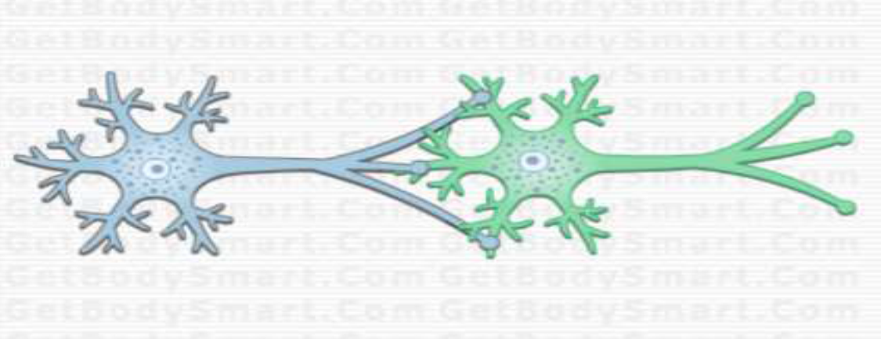
synapse:
Junction between two neuron.
Nerve impulse is an action potential propagated along the nerve of the neuron.
Nerve impulse is transmit to other cell at the synapse

Slide 3
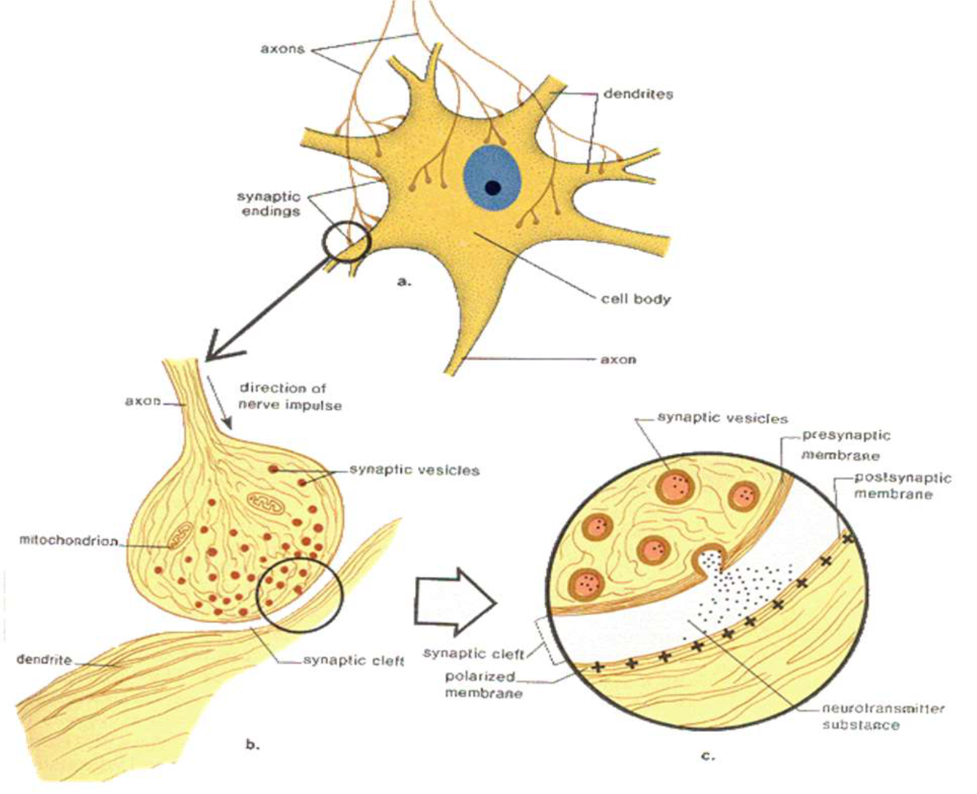

Slide 4
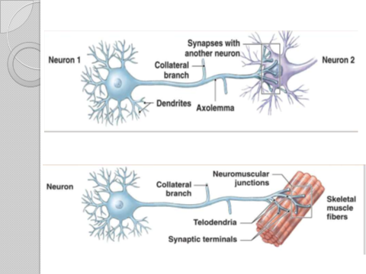

Slide 5
FUNCTIONS OF SYNAPSE
Main function of the synapse is to transmit the impulses, i.e. action potential from one neuron to another.
In a chemical synapse, electrical activity in the presynaptic neuron is converted into the release of a chemical called a neurotransmitters.
Neurotransmitters binds to receptors located in the plasma membrane of the postsynaptic cell.

Slide 6
Definition
Autonomic nervous system
It is the system for involuntary subconscious functions , it controls the internal environment to maintain homeostasis .

Slide 7
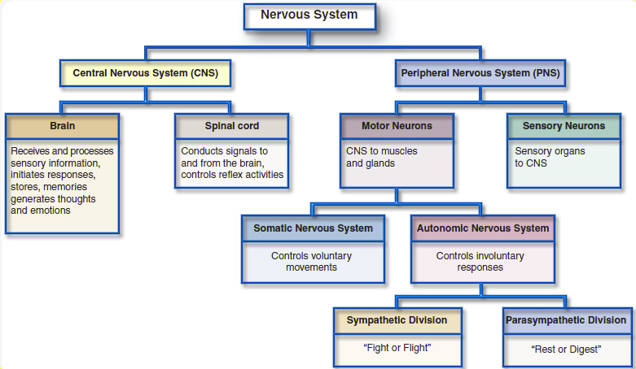

Slide 8

ANS - is the efferent pathway to involuntary visceral activities
It has two subdivisions:
1-The sympathetic nervous system
2-Parasympathetic nervous system
In both system the efferent pathway is composed of two neurons:
1- Preganglionic neuron located inside the central nervous system (CNS).
2- postganglionic neurons located outside the CNS in ganglia.

Slide 9
Sympathetic division of ANS:
Sympathetic division is otherwise called thoracolumbar
The fibers arising from12 thoracic and first two lumbar segments of spinal cord are known as preganglionic fibers,

Slide 10
Pre ganglionic fibers leave the spinal cord and terminate in the postganglionic neurons, which are situated in the sympathetic ganglia.
Sympathetic division : In emergencies that cause stress and require us to “fight” or “flight.” leads to mobilization & increased metabolism.

Slide 11
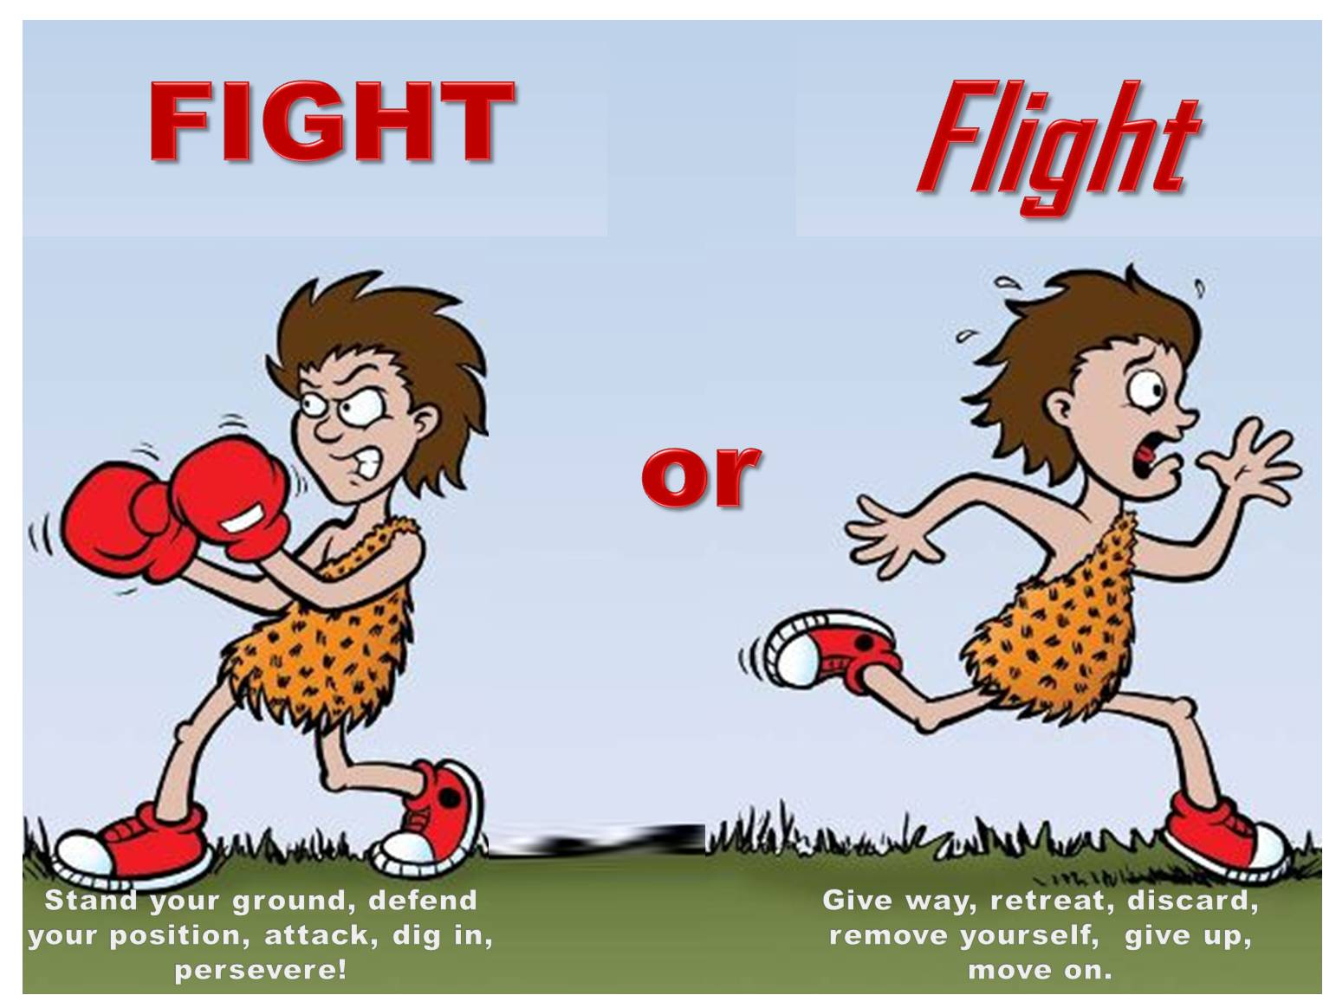
Sympathetic

Slide 12
Parasympathetic division of ANS:
Parasympathetic division is otherwise called craniosacral
the fibers of this division arise from brain and sacral segments of spinal cord.
Fibers leave the spinal cord and end on postganglionic neurons, which are situated near the visceral organs.

Slide 13
Parasympathetic: routine maintenance is allow us to “rest” & “digest”.
Both serve most of the same organs but cause opposing or antagonistic effects

Slide 14

Parasympathetic

Slide 15
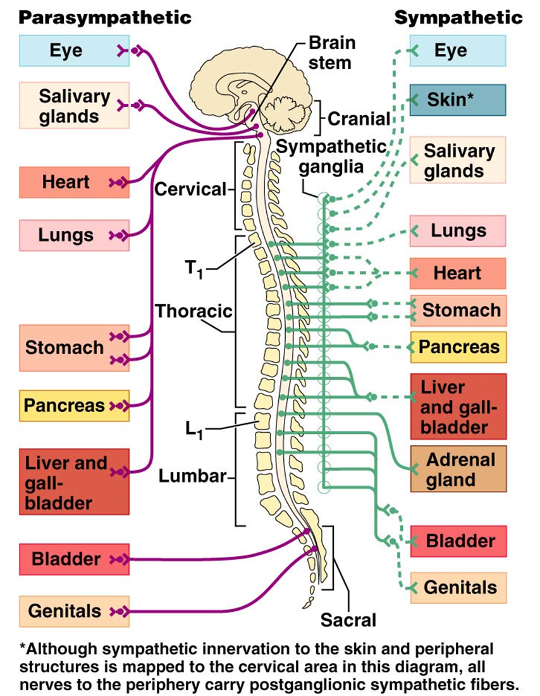
Anatomical Differences
Issue from different regions of the CNS
Sympathetic - the thoracolumbar division
Parasympathetic – the craniosacral division

Slide 16
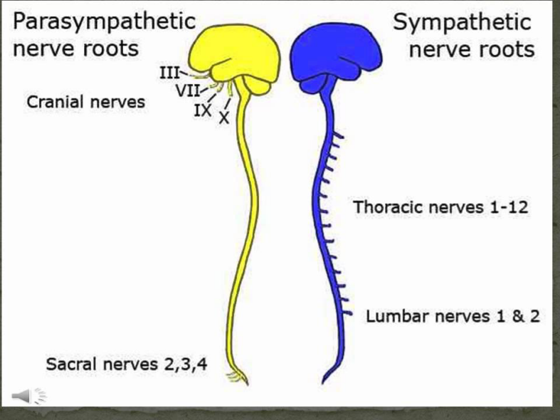

Slide 17
Differences between sympathetic and parasympathetic divisions

Slide 18
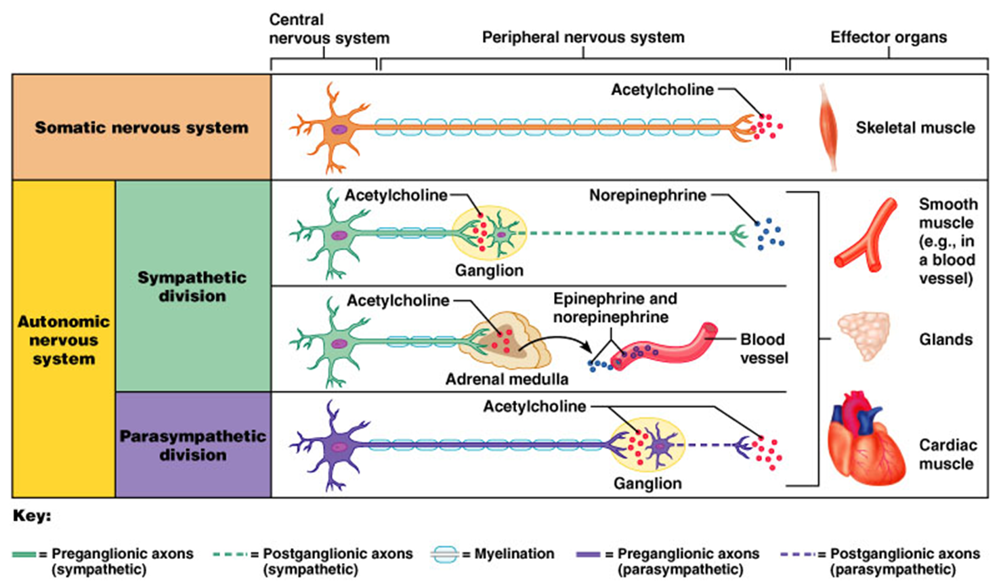
Differences between sympathetic and parasympathetic divisions

Slide 19
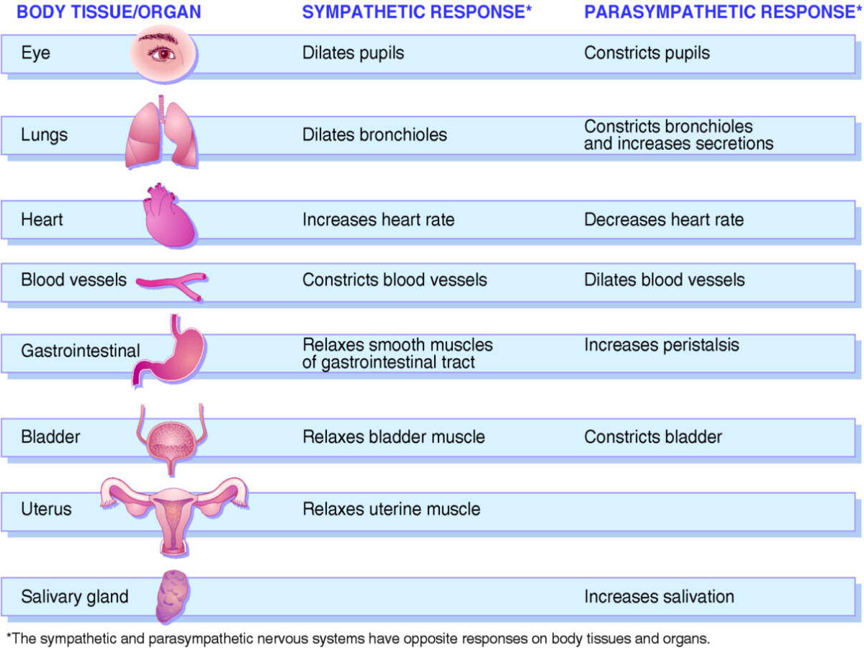

Slide 20
Neurotransmitters of the ANS
Neurotransmitters are chemical substance that is released at the end of a nerve to transfer of the impulse to another nerve fiber.
The neurotransmitteres of the ANS fibers are mainly:
1-Acetylcholine (ACh)
2-Norepinephrine (Noradrenaline)

Slide 21
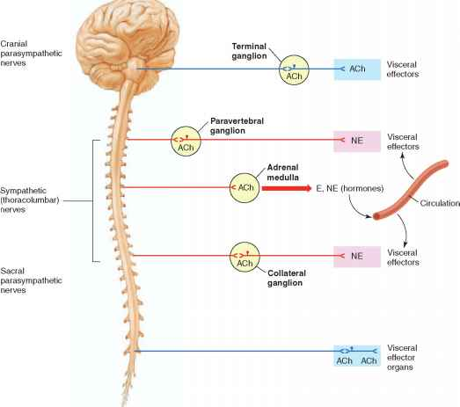
Fibers secreting ACh are called = Cholinergic fibers
Fibers secreting norepinephrine are called= Adrenergic fibers

Slide 22
* Cholinergic nerve fibers are:
All preganglionic nerve fibers in the ANS.
All postganglionic fibers of the parasympathetic ANS.
Some of the postganglionic sympathetic nerve fibers:
(to sweat glands, to piloerector muscles of the hair , few blood vessels)
* Adrenergic nerve fibers are:
Most postganglionic sympathetic nerve fibers.

Slide 23
Receptors in the ANS
Cholinergic receptors (Acetylcholine receptors):
1- Nicotinic receptors:
Nicotinic receptors are found on the
postganglionic cell bodies in all autonomic
ganglia.
Response to acetylcholine released from
both sympathetic and parasympathetic

Slide 24
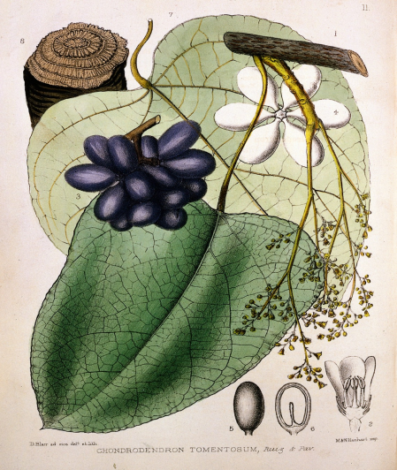

N1 in the synapse of somatic nerves with skeletal muscles (neuromuscular junctions)
(Blocked by curare)
N2 in the postganglionic neurons in all autonomic ganglia (Sympathetic and parasympathetic)
(Blocked by Hexamethonium )

Slide 25
2-Muscarinic receptors:
Found on cell membranes of effector
organs .
They bind with acetylcholine released from parasympathetic postganglionic nerve fiber

Slide 26
Adrenergic receptors (adrenoceptors):
Receptors which are activated by norepinephrine (noradrenaline) and epinephrine (adrenaline)
Found in target organs supplied by adrenergic postganglionic sympathetic fibers
Two main types :
1- α ( alpha1, alpha2)
2- β ( Beta1 , Beta 2, Beta 3)

Slide 27
β1-Adrenergic receptors are located mainly in the heart.
Sensitive to both epinephrine and norepinephrine
β2-Adrenergic receptors are located mainly in the lungs
sensitive to epinephrine only.

Slide 28
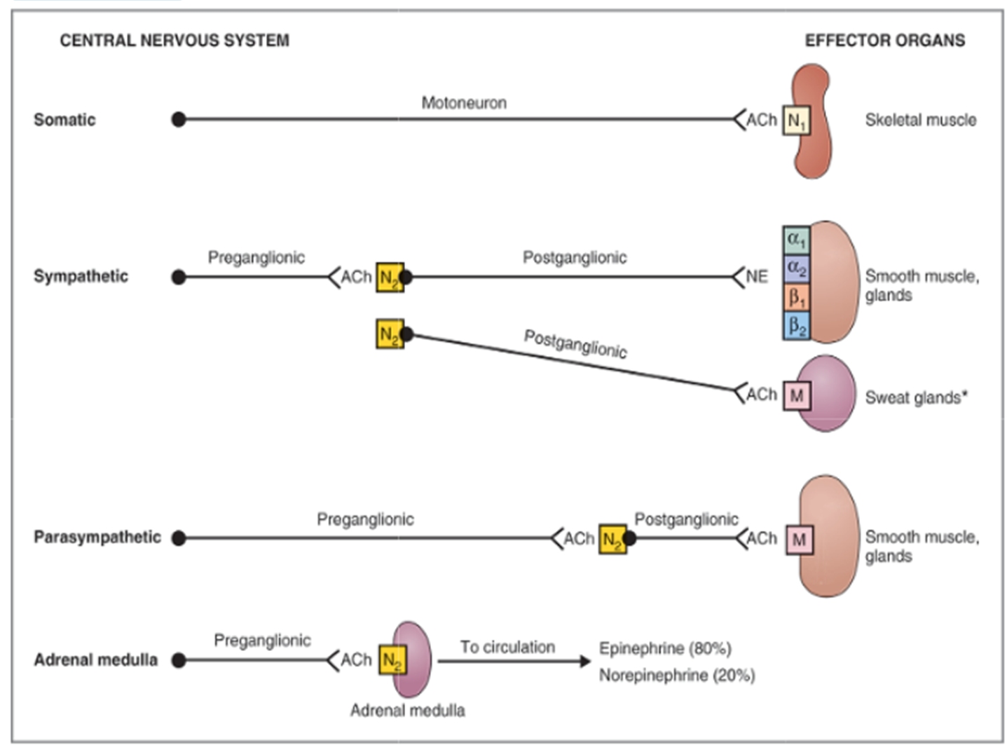

Slide 29
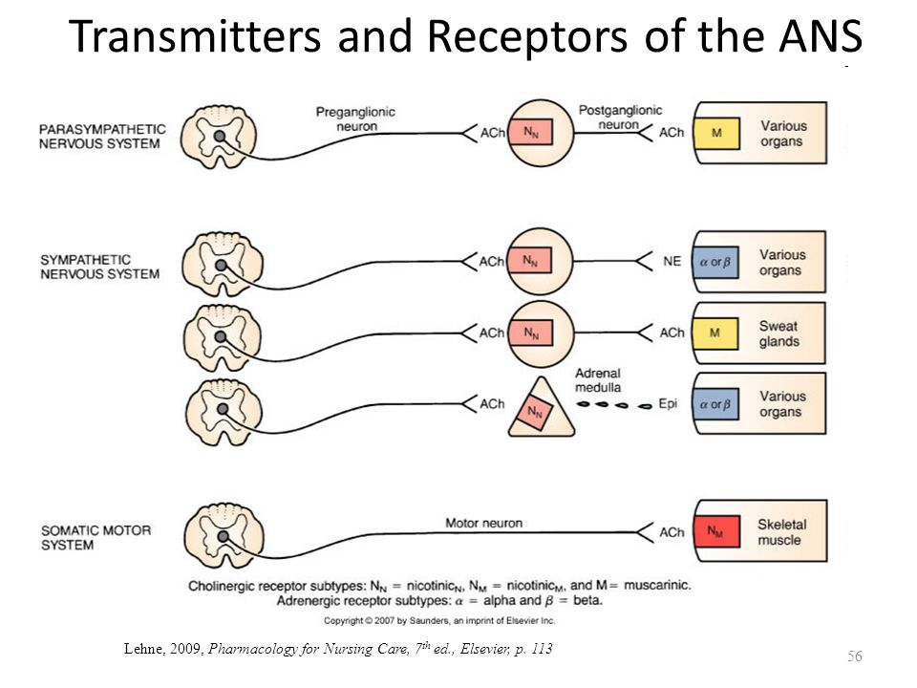

Slide 30
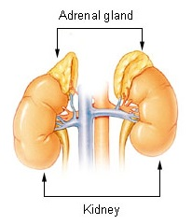
ADRENAL GLAND
Is a gland found on top of kidneys
One of organs of the sympathetic nervous system
Release adrenaline
and noradrenaline
directly to the blood

Slide 34
Pharmacology of the
ANS

Slide 35
Because the nature of signal transmission in autonomic ganglia is a chemical transmission it is a good site for pharmacologic manipulation:
1-Synthesis and storage of the neurotransmitter
2-Release of the neurotransmitter
3-Binding to the receptor
(All these sites can be targeted by chemicals)

Slide 36
1- Adrenergic Agonist (Sympathomimetic)
the drugs, which produce the effects of sympathetic stimulation.
Adrenaline and noradrenaline produced in the body act only for a short duration of about 1 to 2 minutes.
Whereas, sympathomimetic drugs injected intravenously act for a longer period of about 30 minutes to 2 hours.

Slide 37
Sympathomimetic drugs are:
A-Drugs Stimulating the Receptors Directly
1. alpha receptors e.g (Phenylephrine)
2. beta receptors e.g (Isoproterenol)
3. Selective B receptors e.g Salbutamol (beta2 receptors).
B-Drugs Inducing the Release of Noradrenaline
1. Ephedrine
2. Amphetamine.

Slide 38
2- Adrenergic Blocking drugs
(sympatholytic or anti sympathetic)
drugs that can decrease the sympathetic activity
Affect synthesis, storage or release of the neurotransmitter: Methyldopa (aldomet)
Adrenergic receptor blockers:
1-alpha blockers: e.g phentolamine
2-beta blockers : e.g Propranolol ( Inderal )

Slide 39
a. Alpha blockers
prazosin (Minipress)
b. Beta blockers
1. selective B1 (cardio selective)
*Atenolol ( Tenormin)
*Metroprolol (Lopressor)
2. non selective
*propranolol (Inderal)

Slide 40
3- Cholinergic agonist (Parasympathomimetic)
Increase the activity of parasympathetic
Cholinenergic drugs:
Drugs that directly stimulates muscarinic receptors):
eg Pilocarpine
Drugs which inhibit acetylcholine esterase : prevent degradation of ACh and there by potentiates its effect eg. Neostigmine

Slide 41
4-Parasympathetic blockers
Parasympathetic blockers are drugs, which prevent the actions of parasympathetic neurotransmitter.
The drugs:
Atropine and scopolamine inhibit the
actions of Ach by blocking the muscarinic receptors.

Slide 42
Applied physiology

Slide 43
Horner’s Syndrome
Results from damage to sympathetic neurons that supply the face
The syndrome is characterized by the following signs (on the affected side of the face):
Ptosis (drooping of the upper eye lid)
Meiosis (constriction of the eye pupil)
Anhydrosis (dryness, due to loss of sweating)
Enophthalmos (abnormal recession of the eyeball in the orbit)

Slide 44
